Slide 1
Strategies for Taking Standardized Tests

Slide 2
‘Twas the Night Before Testing
Go to bed on time.
Put a few number 2 pencils with erasers in your backpack.
Solve family/friend problems before the testing date.
Talk to your parents about any concerns that you might have about the test.

Slide 3
The Morning of Testing
Start your day as you always do.
Eat a good breakfast.
Think of what you will do to relax after you get home from school.
Think Positive!

Slide 4
Multiple Choice Questions
If you do not understand the directions, ask for help.
Read the question and all answer choices before marking anything.

Slide 5
Pace Yourself
Don’t spend too much time on any one question. Do your best and then move on.
Answers the easiest questions first, but be sure to go back to those questions you skipped.

Slide 6
Multiple Choice Questions
Do not change your answers unless you are very uncertain about your first answer choice.
Try to answer every question. Make the most intelligent guess you can.

Slide 7
The Process of Elimination
After you have been through all of the questions once, go back and find questions you have some knowledge about and eliminate choices that you know are incorrect.
I know C isn’t the answer!

Slide 8
The Process of Elimination
If you can eliminate two wrong answers, your chance of choosing the right answer is greater.

Slide 9
Answering Questions
Don't guess blindly, but if you have time to think about the best answer choice, make it!

Slide 10
Skip, Return, Check
If you finish early, check to make sure you have answered all questions.

Slide 11
Key Words
Find key words or phrases in the question that will help you choose the correct answer.

Slide 12
Are we communicating?
Make sure you understand what the question is asking.
Be sure you are responding to the question that is being asked.

Slide 13
Reading Passages
If the test requires you to read passages and then answer questions about what you read,
read the questions first.
By doing this, you will know what you are looking for as you read. This also helps you go faster on the test.

Slide 14
Reading Passages
When there are several questions about a reading passage or chart, look for clues in other questions that will help you with those items about which you are unsure.

Slide 15
Math Computation
When using scratch paper on a math test, double check to make sure that you have copied the problem correctly from the test booklet!

Slide 16
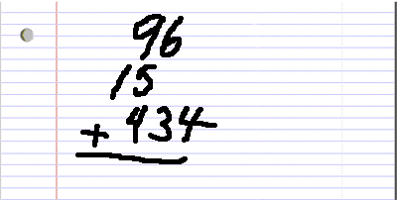
Math Computation
Line up place value correctly on your scratch paper (thousands, hundreds, tens, ones) or the answer will be incorrect.

Slide 17
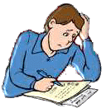
Math Computation
If your answer does not match one of the choices, reread the problem, recopy the numbers, and try solving it again.

Slide 18
A Matter of Time
If any time remains, spend it on those questions about which you know nothing or almost nothing.
As you go back through, do not change all answers.
Remember: Your first guess is usually right.

Slide 19
It’s About Time
Don’t spend too much time rewriting or obsessing about neatness.
Don’t worry if you run out of time.

Slide 20
Final Tips
Fill in bubbles fully, write neatly, and erase stray marks.
Double-check the test number in your test booklet against the answer sheet every few questions to be sure you haven’t gotten on the wrong number.

Slide 21
The Death Grip
If your arm tires during testing it is probably due to the grip that you have on your pencil.
Relax the grip and give those muscles a break.
Do not do arm exercises during testing as this disturbs others.

Slide 22
Thank you, Mr. Know-it-all!
Remember it's okay not to know everything — unlike class tests, these tests will have some questions designed to challenge the limits of your knowledge at a grade level above your current grade.

